Slide 1
The Eukaryotic Cell Cycle: Molecules, Mechanisms and Mathematical Models
John J. Tyson
Biological Sciences, Virginia Tech
& Virginia Bioinformatics Institute
Funding: NIH-GMS

Slide 2
G2
S
Prophase
The cell cycle is the
sequence of events whereby
a growing cell replicates all
its components and divides
them more-or-less evenly
between two daughter cells
...
DNA synthesis
Metaphase
Anaphase
G1
+
Telophase
cell division

Slide 3
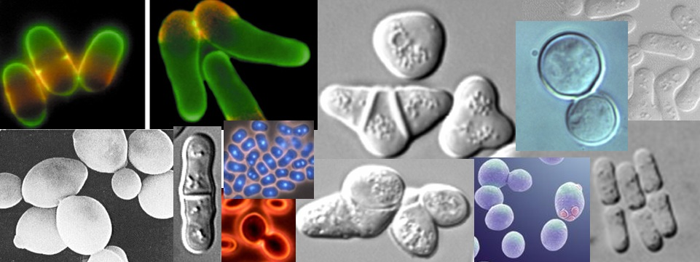
Why study the cell cycle?
All living organisms are made of cells.
All cells come from previously existing cells by the process of cell growth and division.

Slide 4
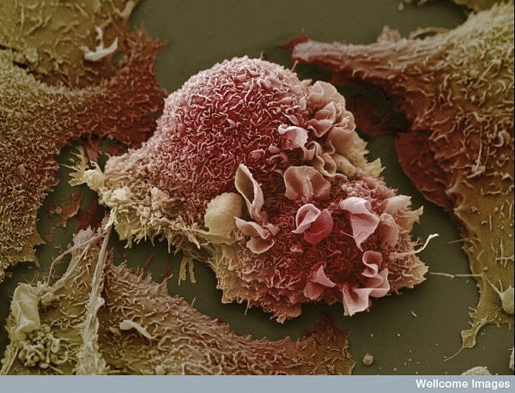
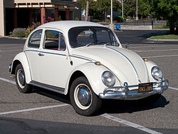
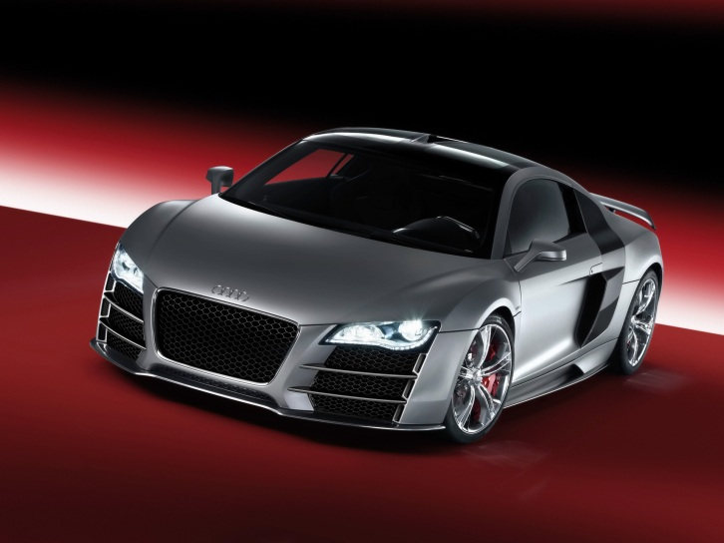
Why study budding yeast?

Slide 5
G2
S
Prophase
Alternation of DNA synthesis and mitosis
Checkpoints
Balanced growth and division
Robust yet noisy
DNA synthesis
Metaphase
Anaphase
G1
+
Telophase
cell division

Slide 6
G2
S
Prophase
Clb2
Clb5
DNA synthesis
Cdk
Metaphase
Cln2
Cdc20
APC
Sic1
Cdh1
Anaphase
APC
G1
+
Telophase
cell division

Slide 7
Cdc20
Clb2
Net1
Mcm1_{A}
P
Net1
Net1
Cdc14
Mcm1
APC
APC-P
Cdc14
Cdc20
Clb2
Budding Yeast
Chen et al. (2004)
Cdh1
Sic1
Cdc14
Clb2
Swi5
Cln2
Cdh1
Swi5_{A}
Sic1
Sic1
SBF_{A}
Whi5
Cln3
Cell Size Sensor
Cdh1
Clb5
Whi5
Cdc20
Clb5
SBF_{A}
Cln2
Whi5
P
Clb2
SBF

Slide 8
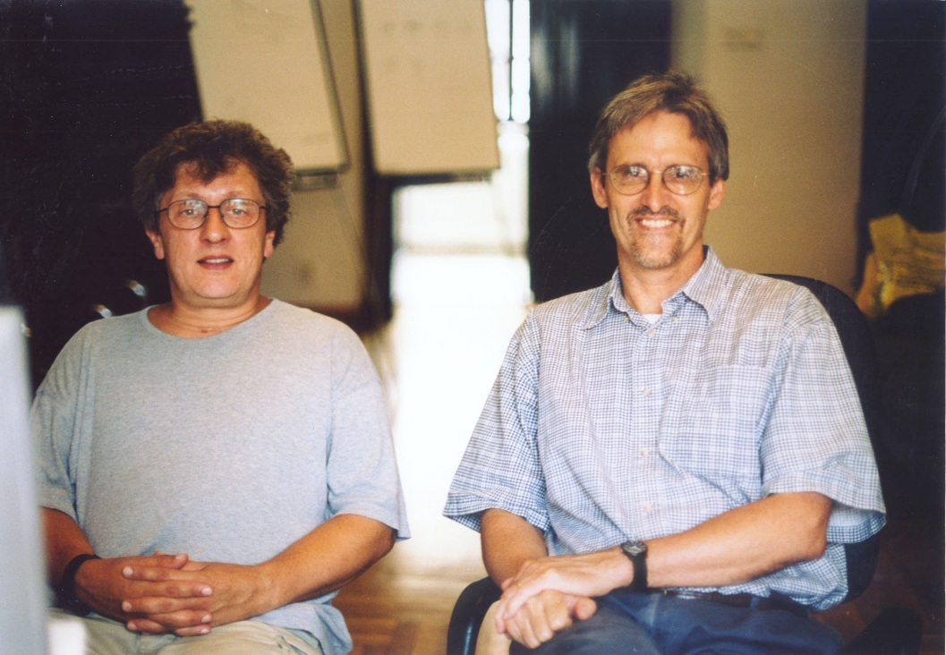
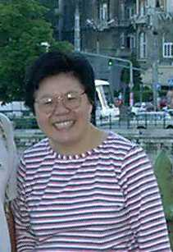
Deterministic Modeling
Bela Novak
Tyson & Novak, “Temporal Organization of the Cell Cycle,” Current Biology (2008)
Tyson & Novak, “Irreversible transitions, bistability and checkpoint controls in the eukaryotic cell cycle: a systems-level understanding,” in Handbook of Systems Biology (2012)
Attila Csikasz-Nagy
Andrea Ciliberto
Kathy Chen

Slide 9
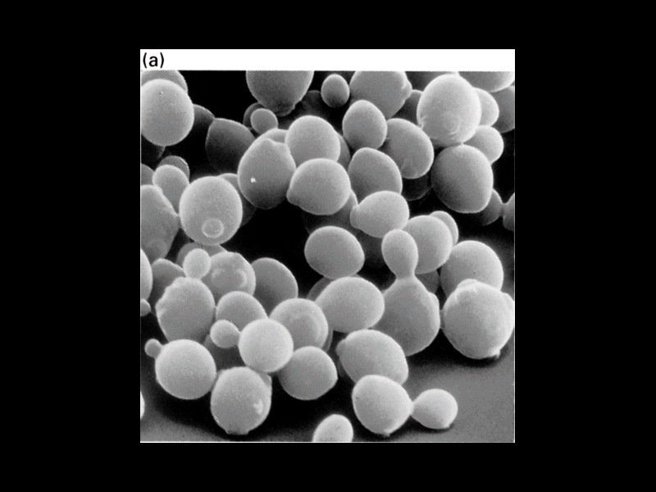
Deterministic Model
Cdc20
Clb2
Net1
Mcm1_{A}
P
Net1
Net1
Cdc14
Mcm1
APC
APC-P
-
Cdc14
Cdc20
Clb2
Budding Yeast
Chen et al.
-
Cdh1
X
Sic1
Cdc14
Clb2
Swi5
Y
Cln2
Cdh1
Swi5_{A}
Sic1
YP
Sic1
SBF_{A}
Whi5
Cln3
Cell Size Sensor
Cdh1
Clb5
Whi5
mechanism
Cdc20
Clb5
SBF_{A}
Cln2
Whi5
P
differential equations
Clb2
SBF

Slide 10
ON
What mechanisms flip
the switch on and off?
Clb2-dep kinase
OFF
S/A, parameter
2
steady state
bifurcation diagram
differential equations

Slide 11
Cdc20
Clb2
Net1
Mcm1_{A}
P
Net1
Net1
Cdc14
Mcm1
APC
APC-P
-
Cdc14
Cdc20
Clb2
Budding Yeast
Chen et al.
-
-
Cdh1
Cln2
Sic1
Cdc14
Clb2
Clb2
Swi5
Cln2
Cdh1
Swi5_{A}
Cdh1
Sic1
Sic1
SBF_{A}
Whi5
Cln3
Cdh1
Clb5
Whi5
-
Cdc20
Clb5
SBF_{A}
Cln2
Whi5
P
Clb2
SBF

Slide 12
Entry
G2/M
Clb2
DNA Synthesis
G1
Cln2

Slide 13
Cdc20
Clb2
Net1
Mcm1_{A}
+
P
Net1
Net1
Cdc14
Mcm1
APC
APC-P
-
Cdc14
Cdc20
Clb2
Budding Yeast
Chen et al.
-
Cdh1
+
Sic1
Cdc14
Clb2
Swi5
Cln2
Cdc14
Cdh1
Clb2
Swi5_{A}
Sic1
Sic1
SBF_{A}
Whi5
Cln3
Cell Size Sensor
Cdh1
Clb5
Whi5
Cdh1
Cdc20
Clb5
SBF_{A}
Cln2
Whi5
P
Clb2
SBF

Slide 14
Exit
G2/M
Clb2
Cell Division
G1
Cdc14

Slide 15
Cln2
Cdc14
Clb2
Cdh1
Clb2
G2
M
A
S
T
G1
G1
Cln2
Cdc14

Slide 16
Cln2
Cdc14
Clb2
Cdh1
Clb2
G2
M
A
S
T
G1
G1
Cln2
Cdc14

Slide 17
Cln2
Cdc14
Clb2
Cln3
Cdh1
Clb2
G2
M
A
S
T
G1
G1
Cln3
Cdc14

Slide 18
Cln2
Cdc14
Clb2
Cln3
Cdh1
Clb2
G2
M
A
S
T
G1
G1
Cln3
Cdc14

Slide 19
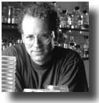
Protocol to demonstrate hysteresis at Start
Cross et al., Mol. Biol. Cell 13:52 (2002)
Genotype: cln1Δ cln2Δ cln3Δ GAL-CLN3 cdc14^{ts}
Fred Cross
Knockout all the G1cyclins
Turn on CLN3 with galactose; turn off with glucose
Temperature-sensitive allele of CDC14: on at 23ºC, off at 37ºC.
“Neutral” conditions: glucose at 37ºC (no Cln’s, no Cdc14)

Slide 20
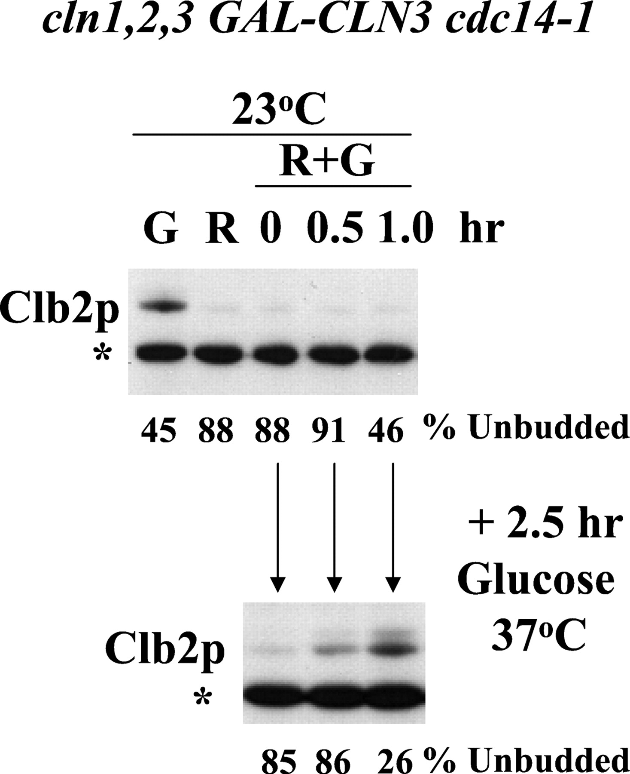
R = raffinose
G = galactose
Start with all
cells in G1
Make some Cln3
Standard for protein loading
Shift to
neutral
G1 cells
S/G2/M cells

Slide 21
Cln2
Cdc14
Clb2
Cdh1
Clb2
G2
M
A
S
T
G1
G1
Cln2
Cdc14

Slide 22
Cln2
Cdc14
Clb2
Cdh1^{CA}
Cdh1
Clb2
G2
M
A
S
T
G1
G1
Cln2
Cdc14

Slide 23
Cln2
Cdc14
Clb2
Cdh1^{CA}
Cdh1
Clb2
G2
M
A
S
T
G1
G1
Cln2
Cdc14

Slide 24
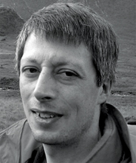
Protocol to demonstrate
hysteresis at Exit
Lopez-Aviles et al., Nature 459:592 (2009)
Genotype: MET-CDC20 GAL-CDH1^{CA} cdc16^{ts}
Frank Uhlmann
Turn off Cdc20;
block in metaphase
Turn on Cdh1; degrade Clb2 and exit from mitosis
Inactivate APC at 37ºC; block any further activity of Cdh1
Add galactose at 23ºC to turn on Cdh1, then
raise temperature to 37ºC to turn off Cdh1

Slide 25
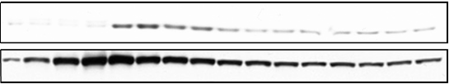
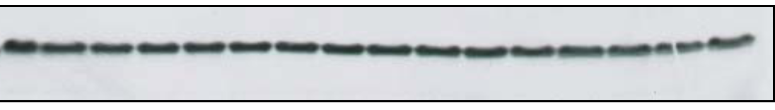
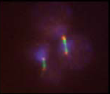
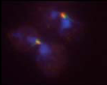
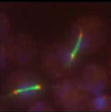
MET-CDC20 GAL-CDH1^{CA} APC^{cdc16(ts)}
37⁰C
Gal
0 10 20 30 40 50 60 70 80 90 100 110 120 130 140 150 min
CycB
CKI
Cdh1^{CA}
Tubulin
0 min
50 min
140 min
metaphase
interphase
metaphase

Slide 26
G2
S
Prophase
Alternation of DNA synthesis and mitosis
Checkpoints
Balanced growth and division
Robust yet noisy
DNA synthesis
Metaphase
Anaphase
G1
+
Telophase
cell division

Slide 27
Cln2
Cdc14
Clb2
Chromosome
Alignment
Problems
DNA Damage
Cdh1
Clb2
G2
M
A
S
T
G1
G1
Cln2
Cdc14

Slide 28
Cln2
Cdc14
Clb2
Growth
Cdh1
Is this deterministic model robust in the face of the inevitable molecular noise in a tiny yeast cell (volume = 40 fL = 40 x 10⁻¹⁵ L)
Clb2
G2
M
A
S
T
G1
G1
Cln2
Cdc14

Slide 29
Molecular Noise
Budding Yeast Cells
Vol = 40 fL
Table 1. Numbers of molecules (per haploid yeast cell)
and half-lives for several cell cycle components.
Cell cycle Gene | # molecules per cell |  | Half-life (min)
 | Protein | mRNA | Protein | mRNA
CDC28 | 6700 | 2.2 | 300 | 23
CLN2 | 1300 | 1.2 | 5 | 10
CLB2 | 340 | 1.1 | 22 | 13
CLB5 | 520 | 0.9 | 44 | 9
SWI5 | 690 | 0.8
MCM1 | 9000 | 1.6 | 300 | 14
SIC1 | 770 | 1.9
CDC14 | 8500 | 1.0 | 20 | 11

Slide 30
Molecular Noise
Budding Yeast Cells
Vol = 40 fL
Table 1. Numbers of molecules (per haploid yeast cell)
and half-lives for several cell cycle components.
Cell cycle Gene | # molecules per cell |  | Half-life (min)
 | Protein | mRNA | Protein | mRNA
CDC28 | 6700 | 2.2 | 300 | 23
CLN2 | 1300 | 1.2 | 5 | 10
CLB2 | 340 | 1.1 | 22 | 13
CLB5 | 520 | 0.9 | 44 | 9
SWI5 | 690 | 0.8
MCM1 | 9000 | 1.6 | 300 | 14
SIC1 | 770 | 1.9
CDC14 | 8500 | 1.0 | 20 | 11

Slide 31
Molecular Noise
Budding Yeast Cells
Vol = 40 fL
Table 1. Numbers of molecules (per haploid yeast cell)
and half-lives for several cell cycle components.
Cell cycle Gene | # molecules per cell |  | Half-life (min)
 | Protein | mRNA | Protein | mRNA
CDC28 | 6700 | 2.2 | 300 | 23
CLN2 | 1300 | 1.2 | 5 | 10
CLB2 | 340 | 1.1 | 22 | 13
CLB5 | 520 | 0.9 | 44 | 9
SWI5 | 690 | 0.8
MCM1 | 9000 | 1.6 | 300 | 14
SIC1 | 770 | 1.9
CDC14 | 8500 | 1.0 | 20 | 11

Slide 32
Molecular Noise
Budding Yeast Cells
Vol = 40 fL
Table 1. Numbers of molecules (per haploid yeast cell)
and half-lives for several cell cycle components.
Cell cycle Gene | # molecules per cell |  | Half-life (min)
 | Protein | mRNA | Protein | mRNA
CDC28 | 6700 | 2.2 | 300 | 23
CLN2 | 1300 | 1.2 | 5 | 10
CLB2 | 340 | 1.1 | 22 | 13
CLB5 | 520 | 0.9 | 44 | 9
SWI5 | 690 | 0.8
MCM1 | 9000 | 1.6 | 300 | 14
SIC1 | 770 | 1.9
CDC14 | 8500 | 1.0 | 20 | 11

Slide 33
Molecular Noise
Budding Yeast Cells
Vol = 40 fL
Table 1. Numbers of molecules (per haploid yeast cell)
and half-lives for several cell cycle components.
Cell cycle Gene | # molecules per cell |  | Half-life (min)
 | Protein | mRNA | Protein | mRNA
CDC28 | 6700 | 2.2 | 300 | 23
CLN2 | 1300 | 1.2 | 5 | 10
CLB2 | 340 | 1.1 | 22 | 13
CLB5 | 520 | 0.9 | 44 | 9
SWI5 | 690 | 0.8
MCM1 | 9000 | 1.6 | 300 | 14
SIC1 | 770 | 1.9
CDC14 | 8500 | 1.0 | 20 | 11

Slide 34
Birth-Death Process

Slide 35
Transcription-Translation
Coupling
Swain, Paulsson, etc.

Slide 36
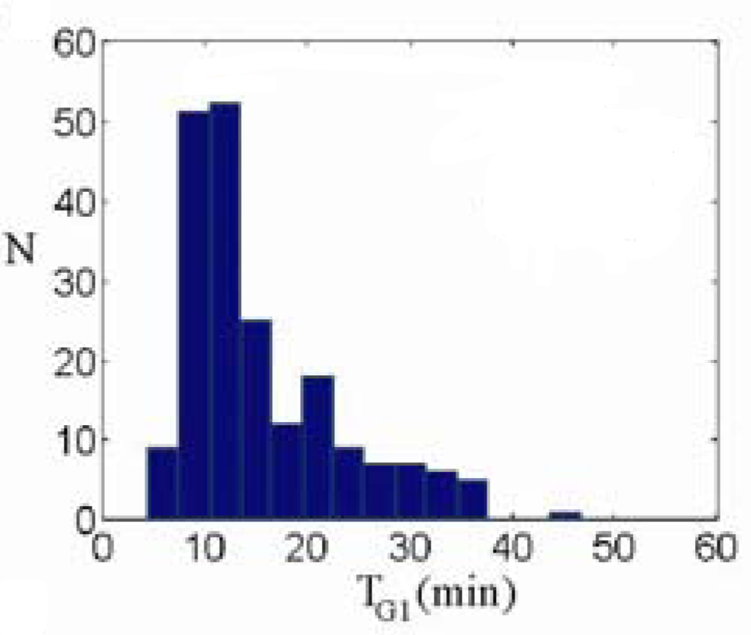
How variable is the yeast cell cycle?
G1 Duration
Mean = 16 min
CV = 48%
S/G2/M Duration
Mean = 74 min
CV = 19%
Cycle Time Mother Daughter | 87 min ± 14% 112 min ± 22%
Size @ Div | 68 fL ± 19%
Di Talia et al., Nature (2007)

Slide 37
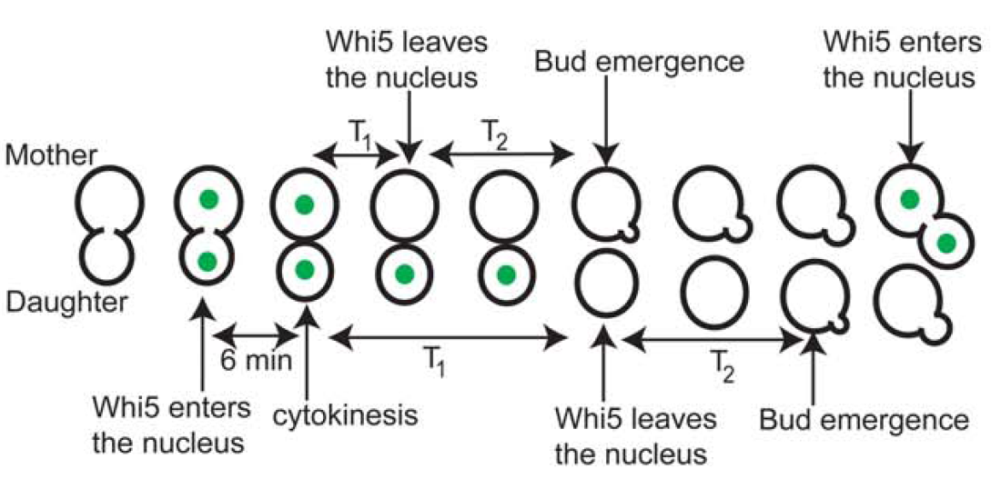
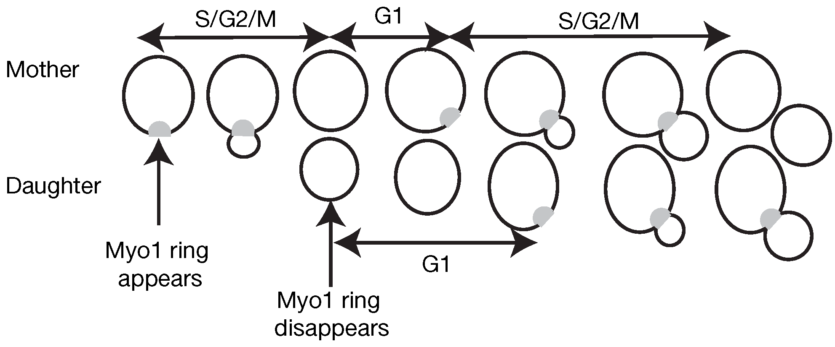
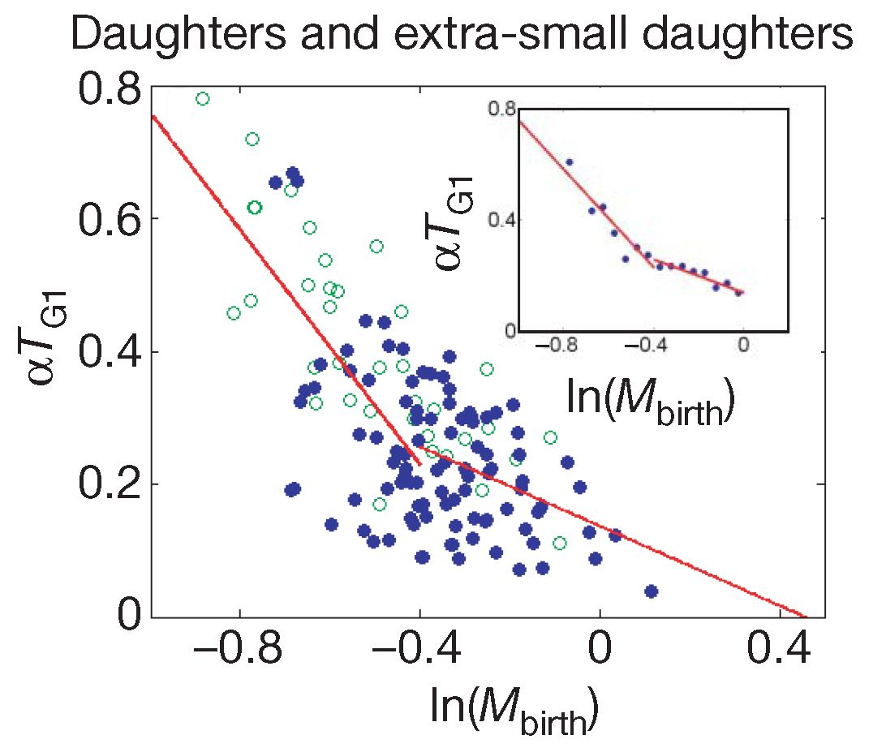
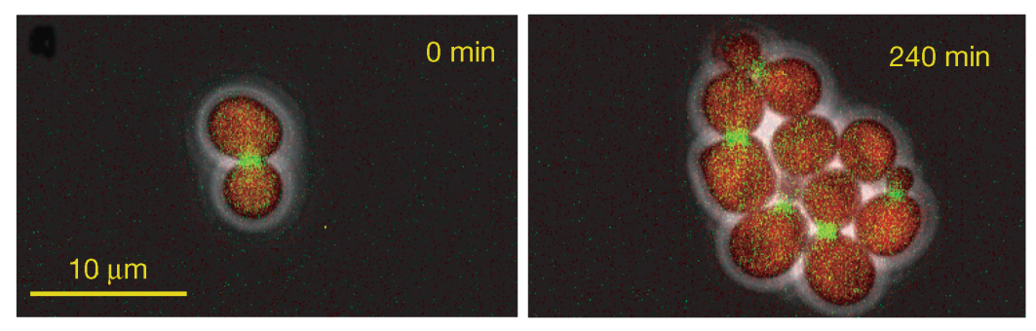
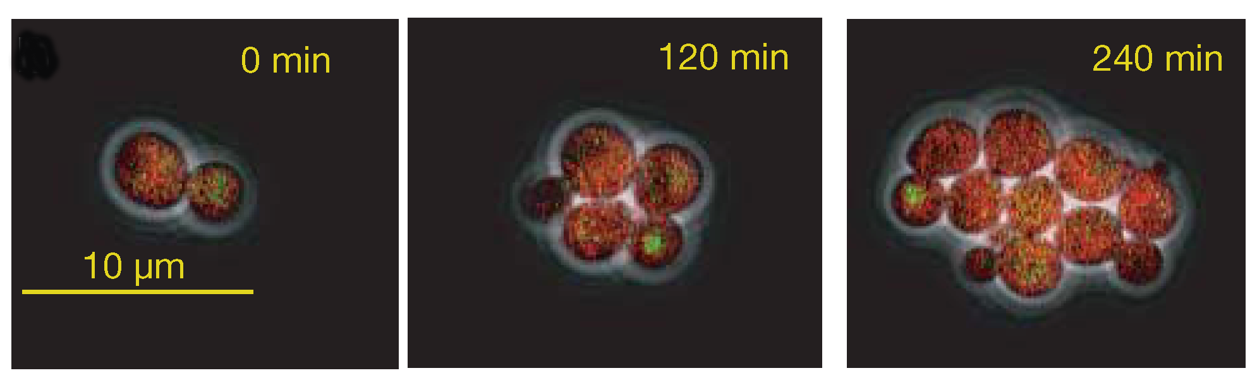
Di Talia et al., Nature (2007)
Daughter Cells
Budding: Myo1-GFP
Cell size: ACT1pr-DsRed
Whi5 exit: Whi5-GFP
Cell size: ACT1pr-DsRed

Slide 38
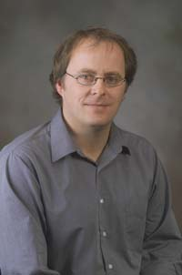

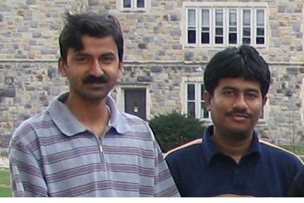
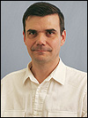
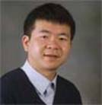
Stochastic Modeling
Bill Baumann
Mark Paul
Debashis Barik & Sandip Kar
Jean Peccoud
Yang Cao

Slide 39
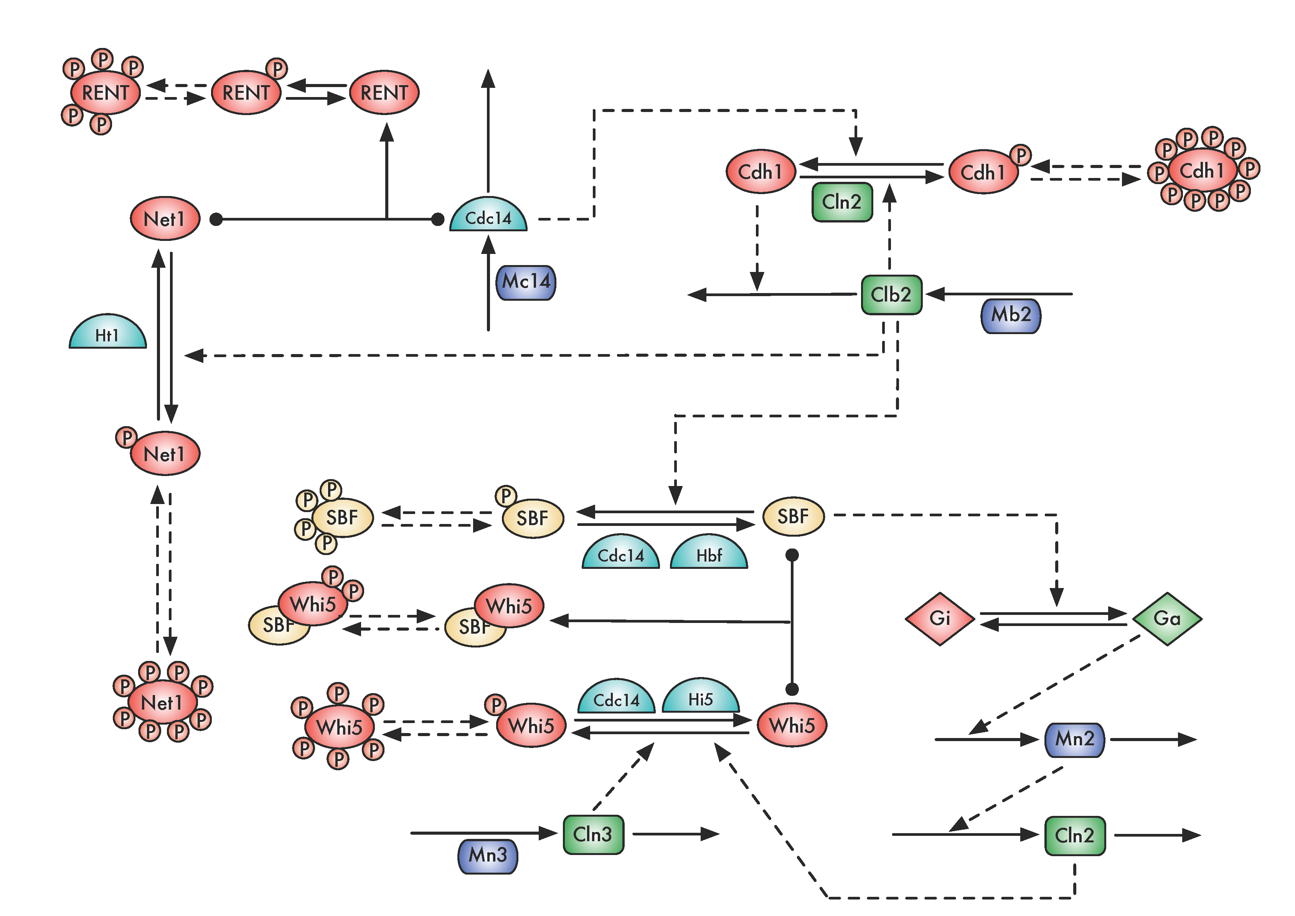
Multisite Phosphorylation Model (Barik, et al.)
Clb2
Cdh1
bistable
switch

Slide 40
Multisite Phosphorylation Model (Barik, et al.)
Cln2
Clb2
Cdh1
Cell size control

Slide 41
Multisite Phosphorylation Model (Barik, et al.)
Cln2
Cdc14
Clb2
Cdh1

Slide 42
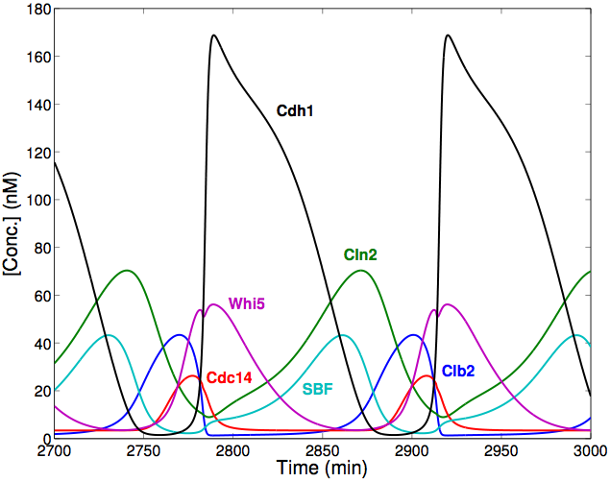
Deterministic calculations
The model consists of 58 species, 176 reactions and 68 parameters
Mass-action kinetics for all reactions
At division daughter cells get 40% of total volume and mothers get 60%

Slide 43
Stochastic calculations
The model consists of 58 species, 176 reactions and 68 parameters
Mass-action kinetics for all reactions
Protein populations: ~1000’s of molecules per gene product
mRNA populations: ~10 molecules per gene transcript
mRNA half-lives: ~ 2 min
Reactions are simulated using Gillespie’s SSA

Slide 44
Experimental data from:
Di Talia et al., Nature (2007)
 |  | Mother | Daughter
Cycle Time (min) | Expt | 87 ± 14% | 112 ± 22%
 | Model | 89 ± 20% | 114 ± 22%
G1 duration (min) | Expt | 16 ± 50% | 37 ± 50%
 | Model | 21 ± 48% | 41 ± 48%
Size@birth (fL) | Expt | 40 ± 18% | 28 ± 20%
 | Model | 41 ± 23% | 28 ± 23%

Slide 45
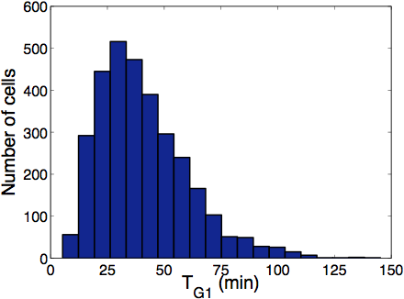
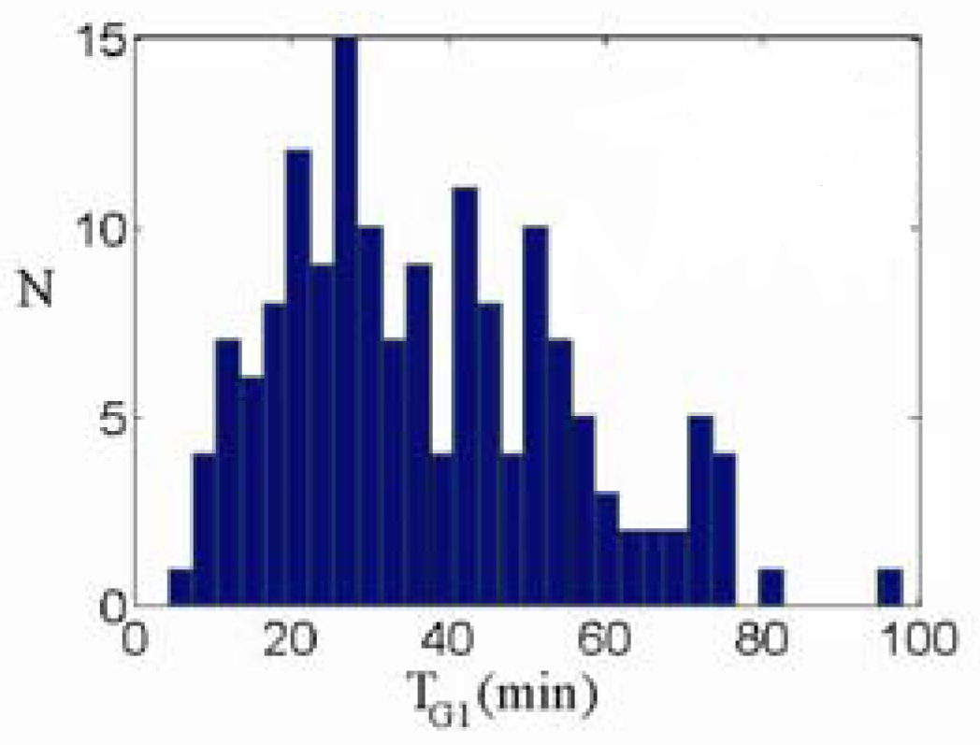
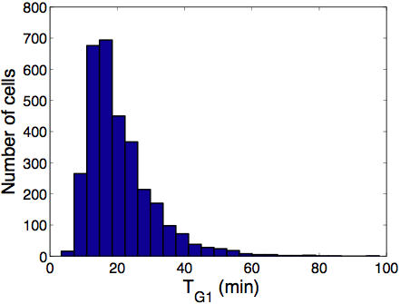
Model
Daughter cells
Di Talia et al.
Model
Mother cells
Di Talia et al.

Slide 46
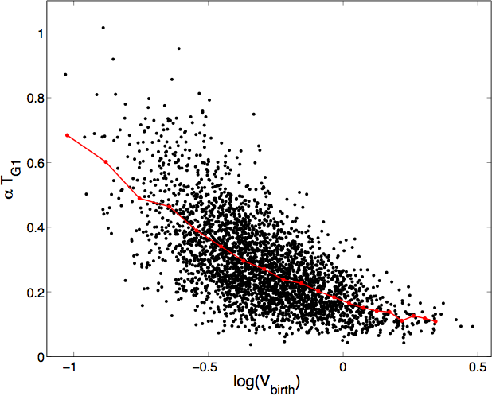
Daughter cells

Slide 47
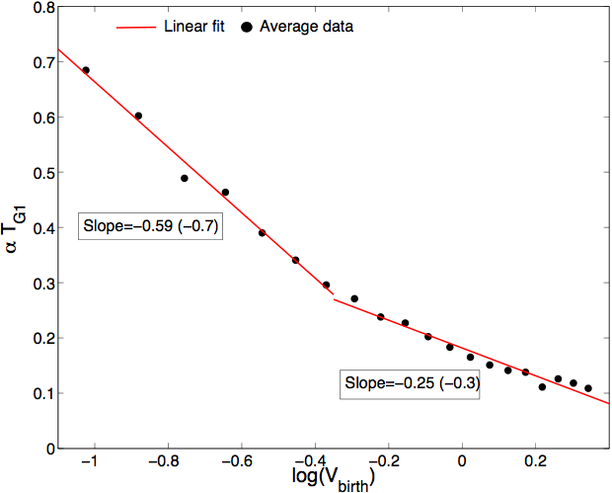
Expt.: Di Talia et al, Nature (2007)

Slide 48
Summary
Cell cycle control in eukaryotes can be framed as a dynamical system that gives a coherent and accurate account of the basic physiological properties of proliferating cells.
The control system seems to be operating at the very limits permitted by molecular fluctuations in yeast-sized cells.
A realistic stochastic model is perfectly consistent with detailed quantitative measurements of cell cycle variability.

Slide 49
Current Biology 18:R759 (2008)
Proc Natl Acad Sci 106:6471 (2009)
Mol Syst Biol 6:405 (2010)
Handbk of Syst Biol (to appear)
Experiment
Computation
Theory

Slide 50
Di Talia et al., Nature (2007)
Start
Whi5
Whi5P
Exit
BE
Cyclin
DNA
synth
Budding: Myo1-GFP
Cell size: ACT1pr-DsRed
Whi5 exit: Whi5-GFP
Cell size: ACT1pr-DsRed

Slide 51
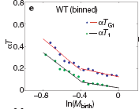
Di Talia et al., Nature (2007)
T₂ = T_{G1} – T₁ = constant
Daughter cell

Slide 52
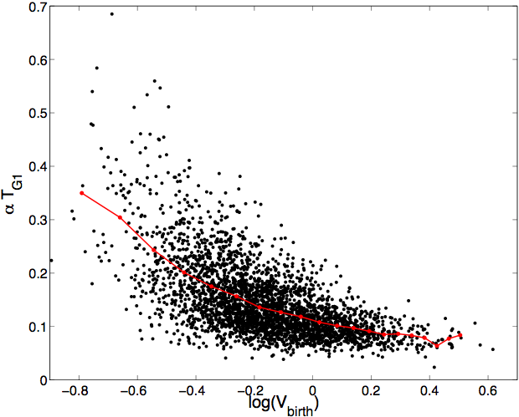
Mother cells

Slide 53
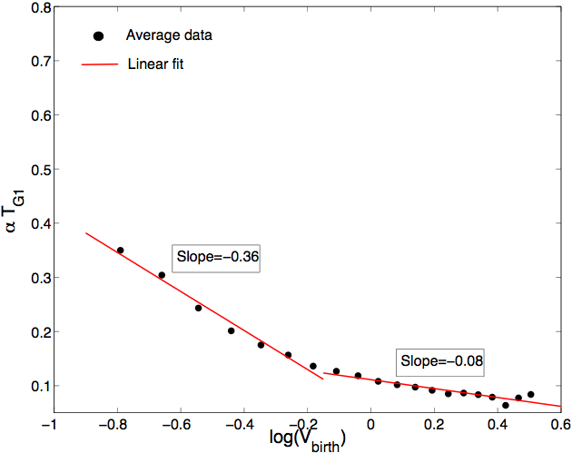
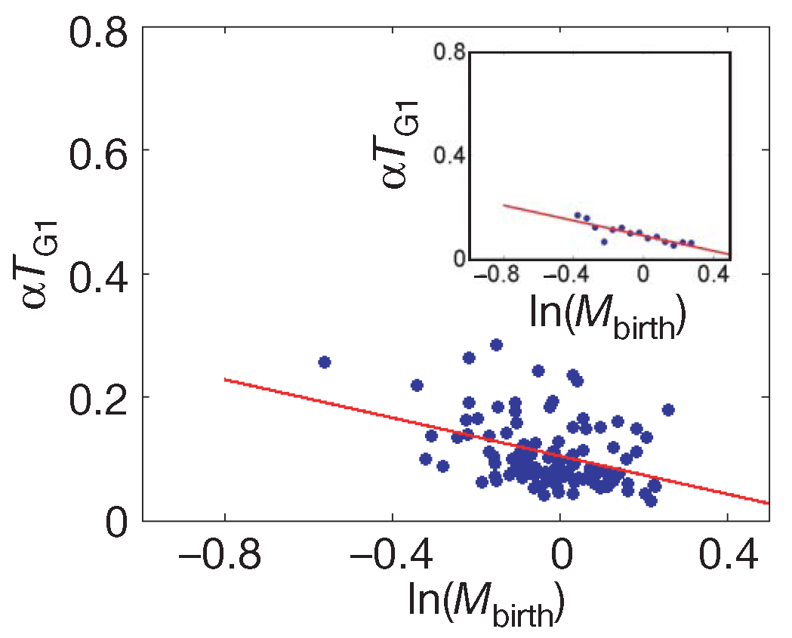

Slide 54
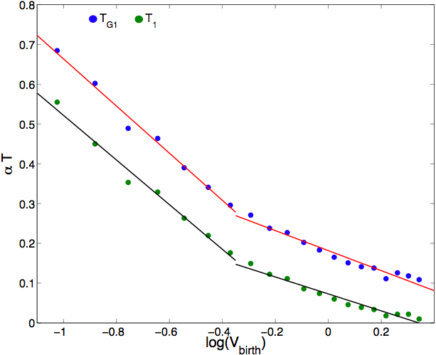
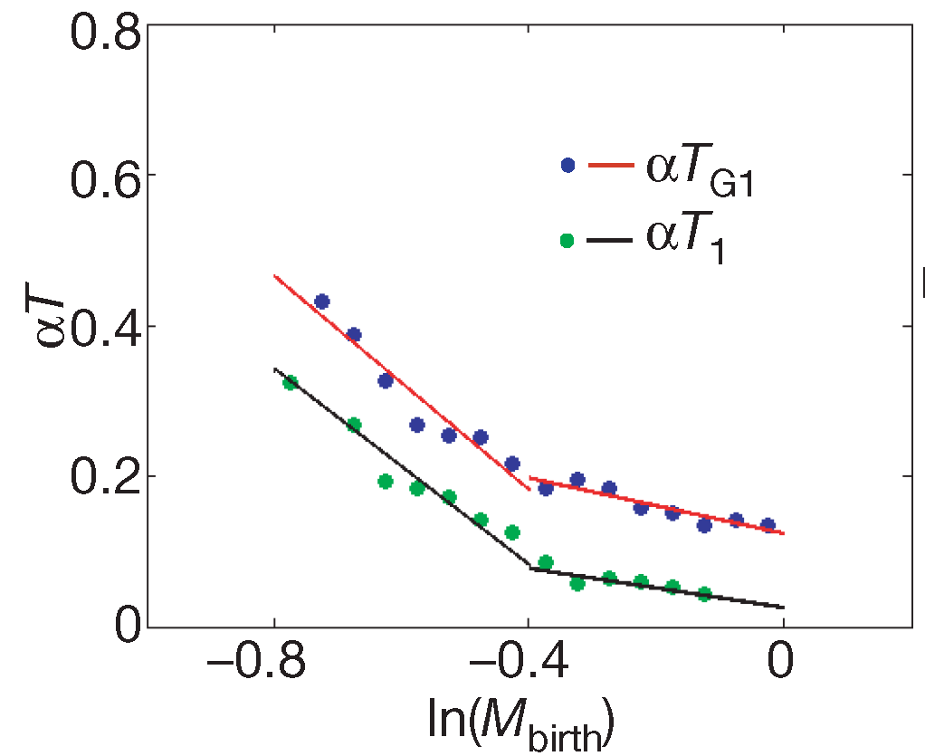
Expt.: Di Talia et al, Nature (2007)
T_{G1}
T₁
T₂
T₁ = Time when Whi5
exits from nucleus
Daughter cells

